Slide 1
CLIPMIND AI
AI Video Summarization & Key Moments Detection Platform

Slide 2
User
Problem Statement
Long videos consume more time.
Users cannot quickly understand
video content.
Manual note-taking is difficult.
Solution
Upload video
Generate transcript
AI summary
Key moments
Quiz generation
Analytics Dashboard
React.js Frontend (User Interface)
Fast API backend
(Business Logic)
PostgreSQL/MongoDB
Database
AI Models
Whisper
BART, T5
File storage (Uploaded videos)
Results, Transcript, Summary, Key Moments
Analytics Dashboard

Slide 3
Objectives:
The main objective of the ClipMind AI project is to develop an intelligent video analysis platform that enables users to securely upload videos, automatically convert speech into text using AI-powered transcription, generate concise summaries, extract important key moments, create quizzes from the video content, and provide an analytics dashboard to monitor uploaded videos and user activity, making video content easier to understand and manage.
Technologies Used:
The ClipMind AI project is developed using React.js for building the interactive frontend and FastAPI with Python for the backend APIs. OpenAI Whisper is used to convert speech from videos into accurate text transcripts, while Ollama (Llama 3.2) is utilized to generate AI-powered summaries, key moments, and quizzes. SQLite serves as the database for storing user and video information, and SQLAlchemy is used as the Object Relational Mapper (ORM) to efficiently manage database operations.

Slide 4
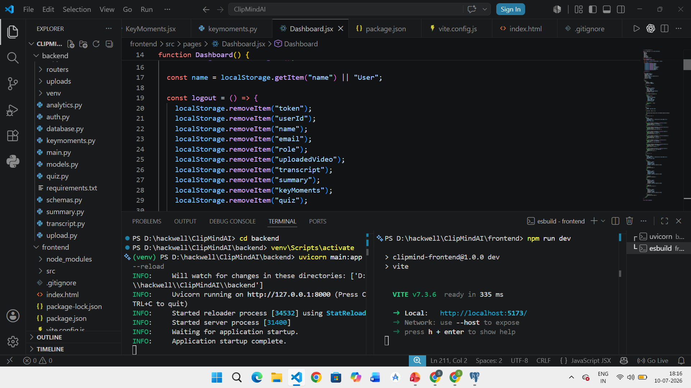

Slide 5
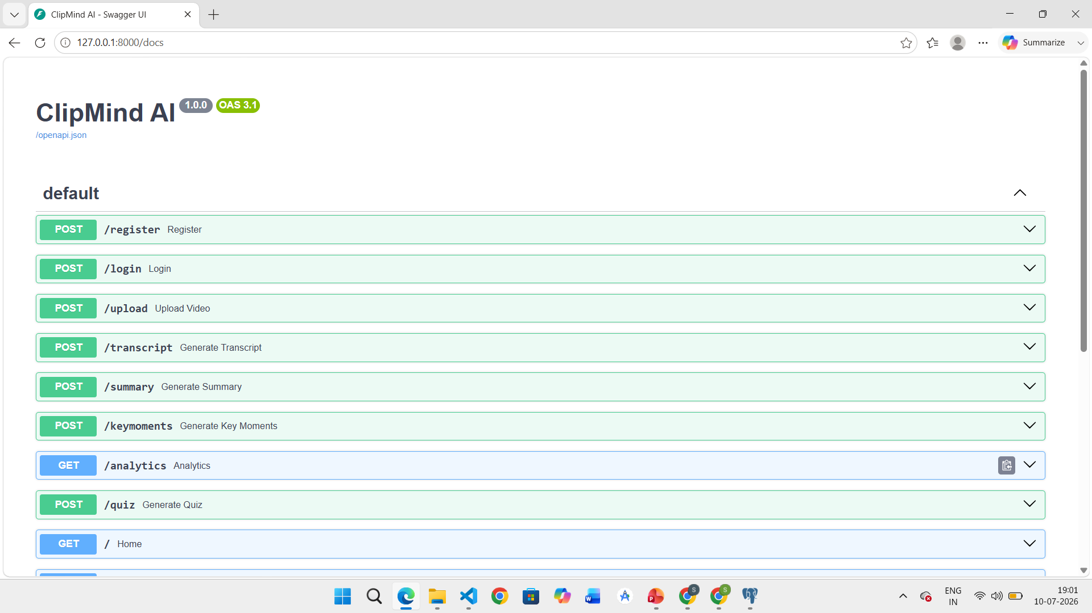

Slide 6
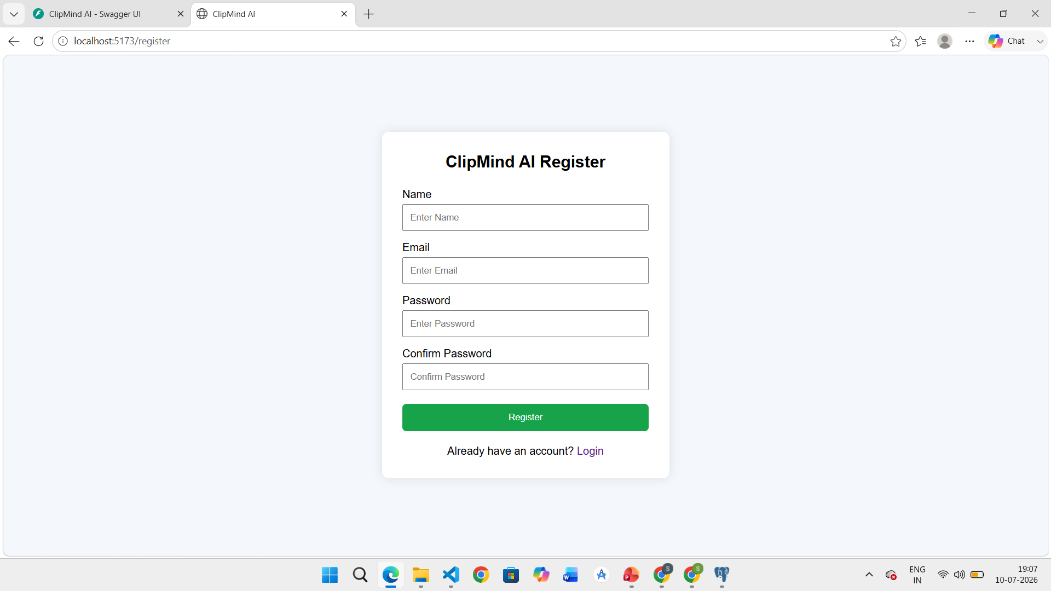

Slide 7
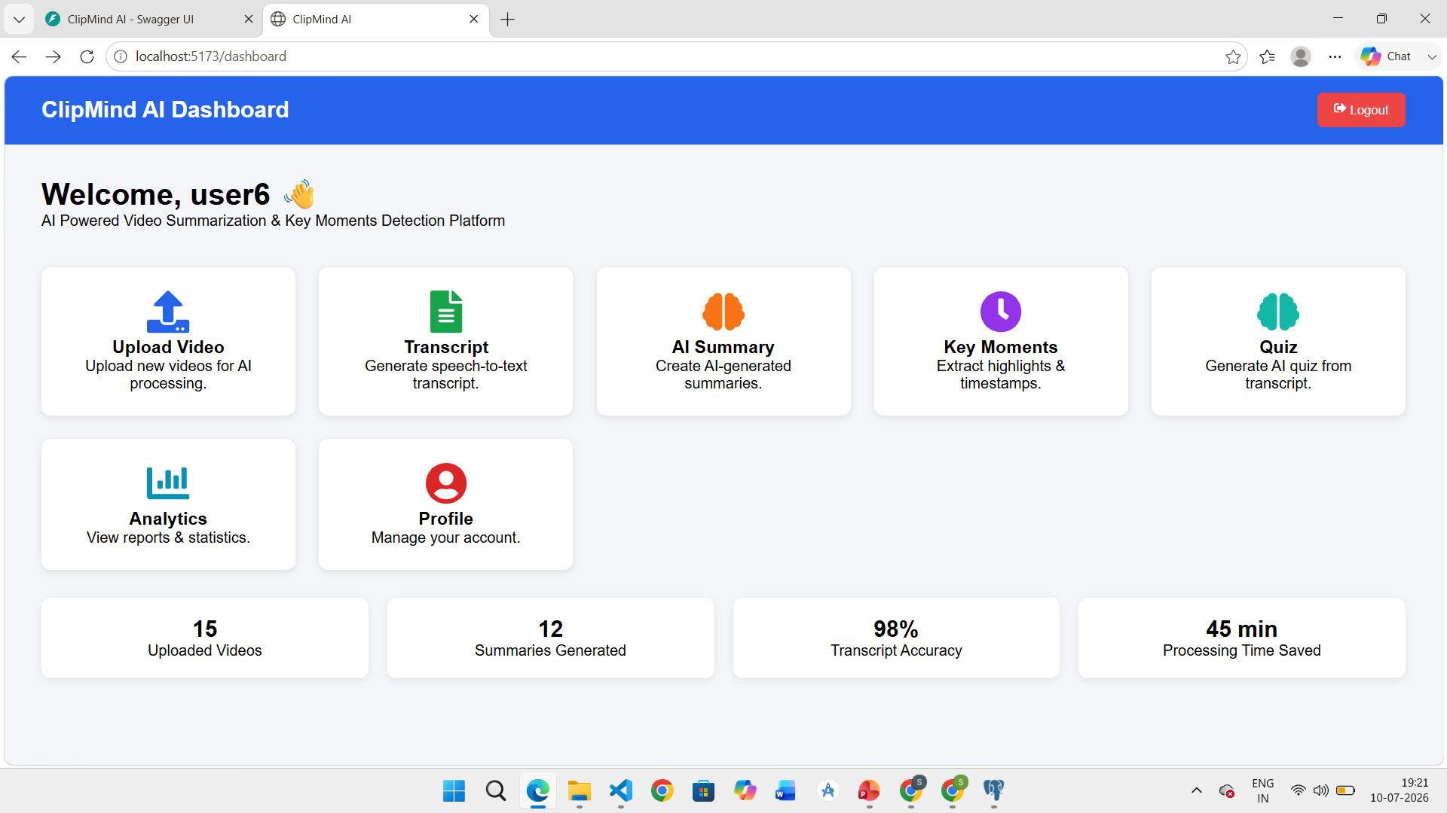

Slide 8
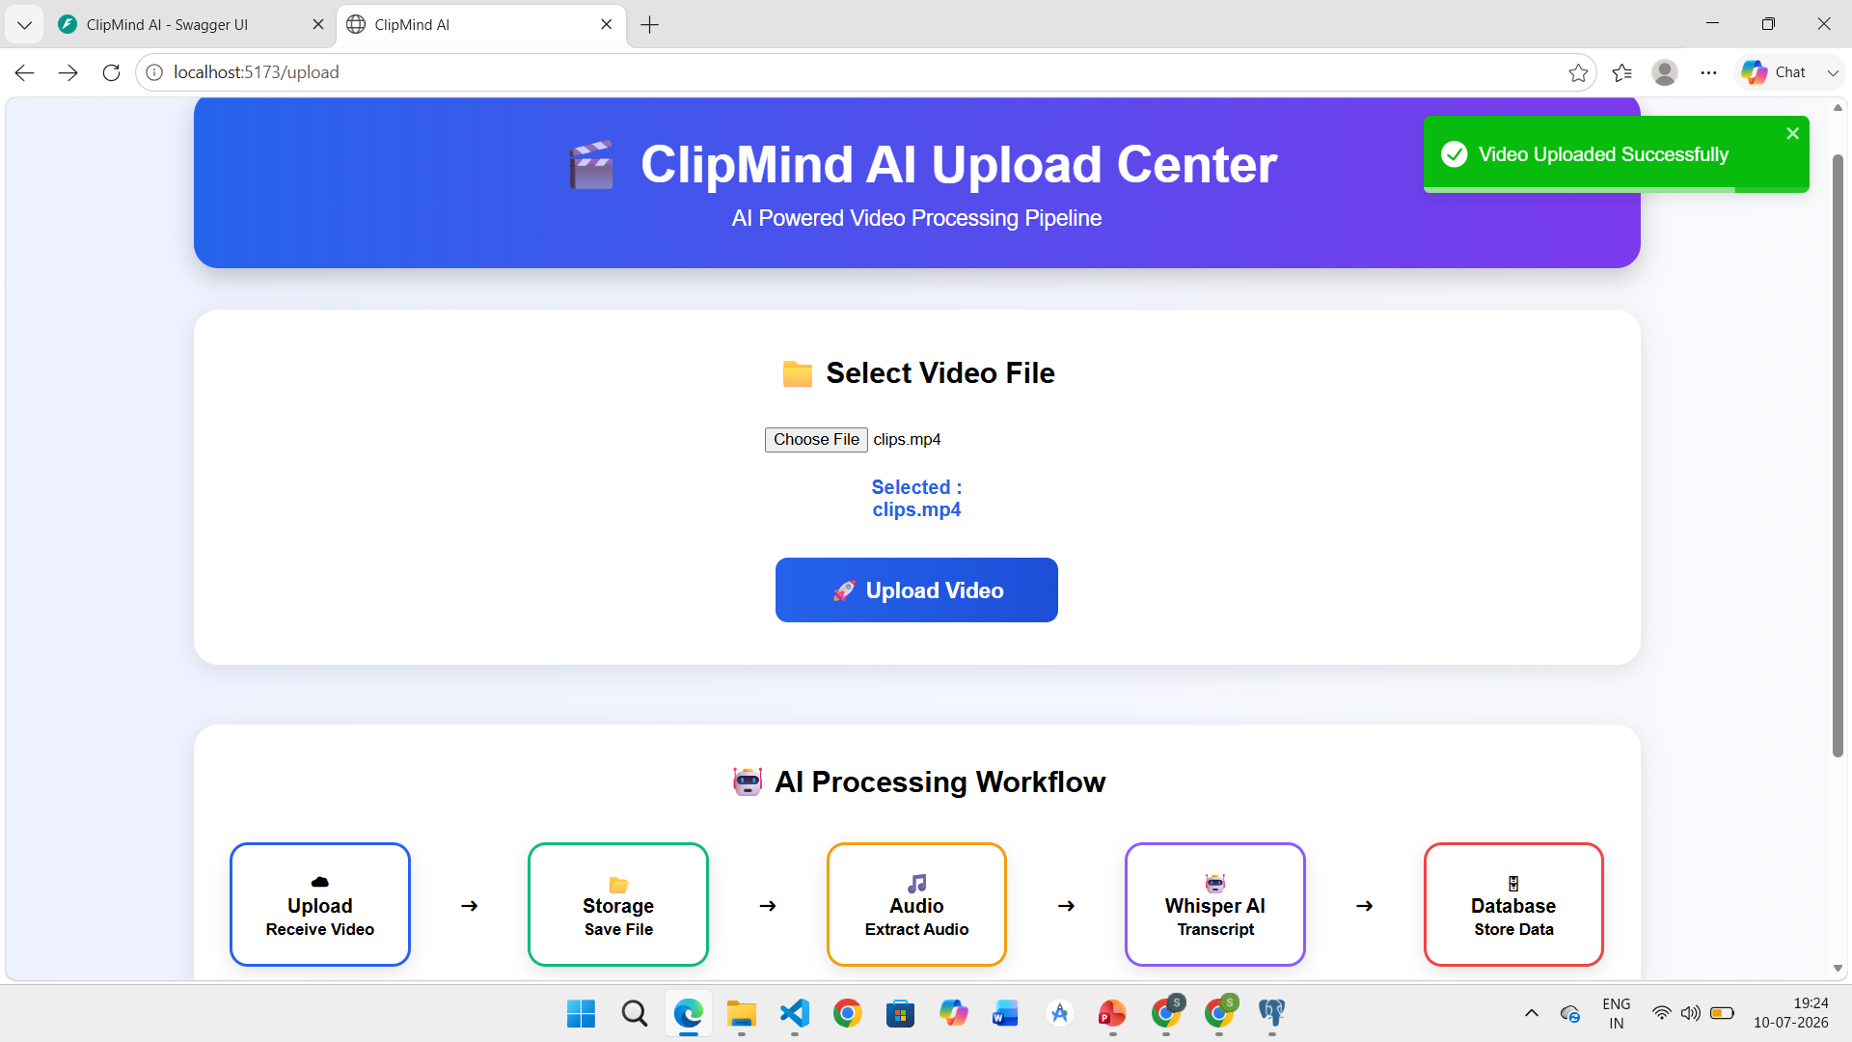

Slide 9
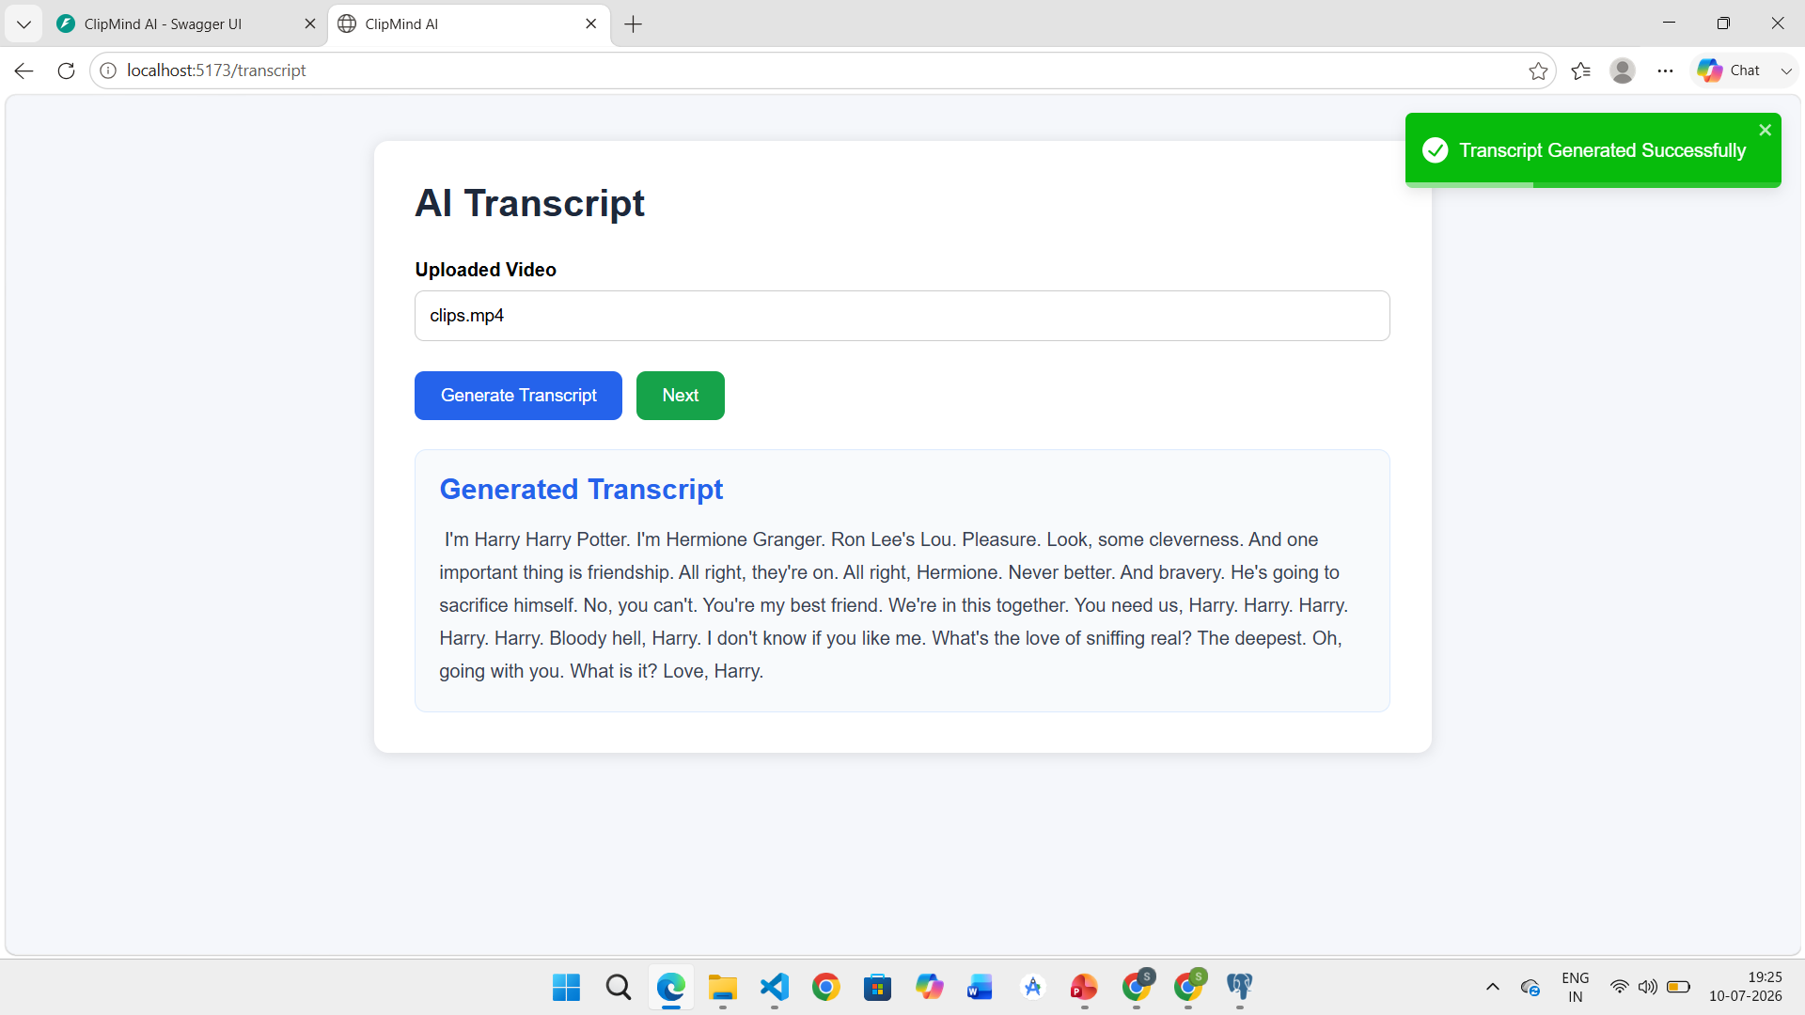
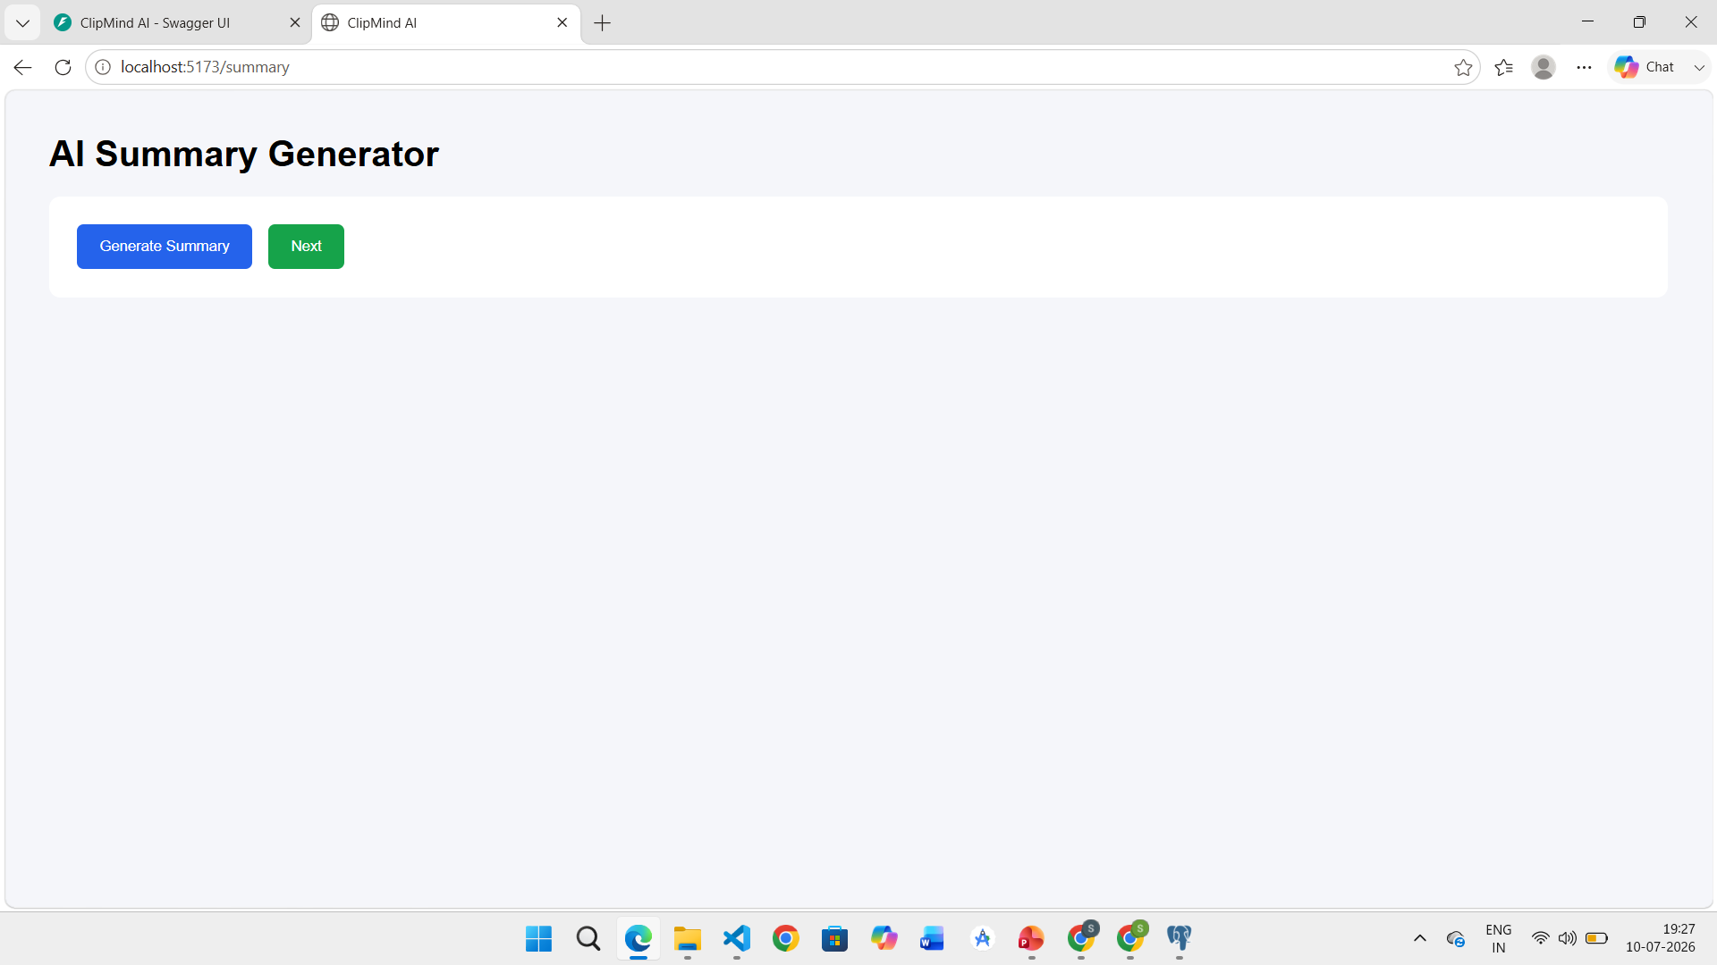
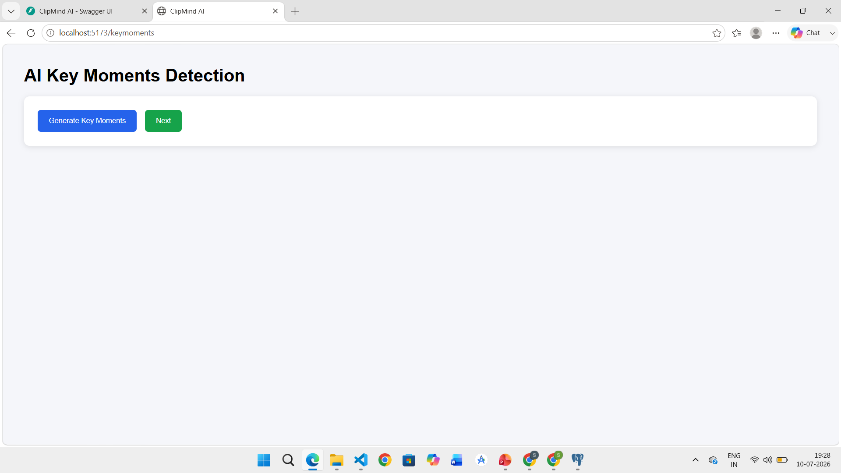

Slide 10
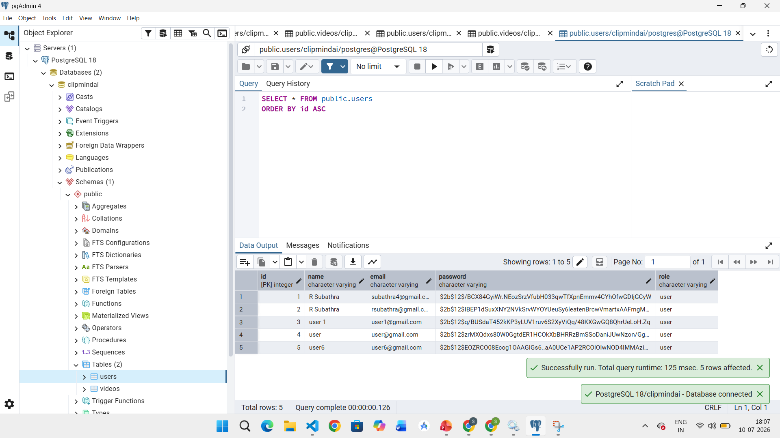
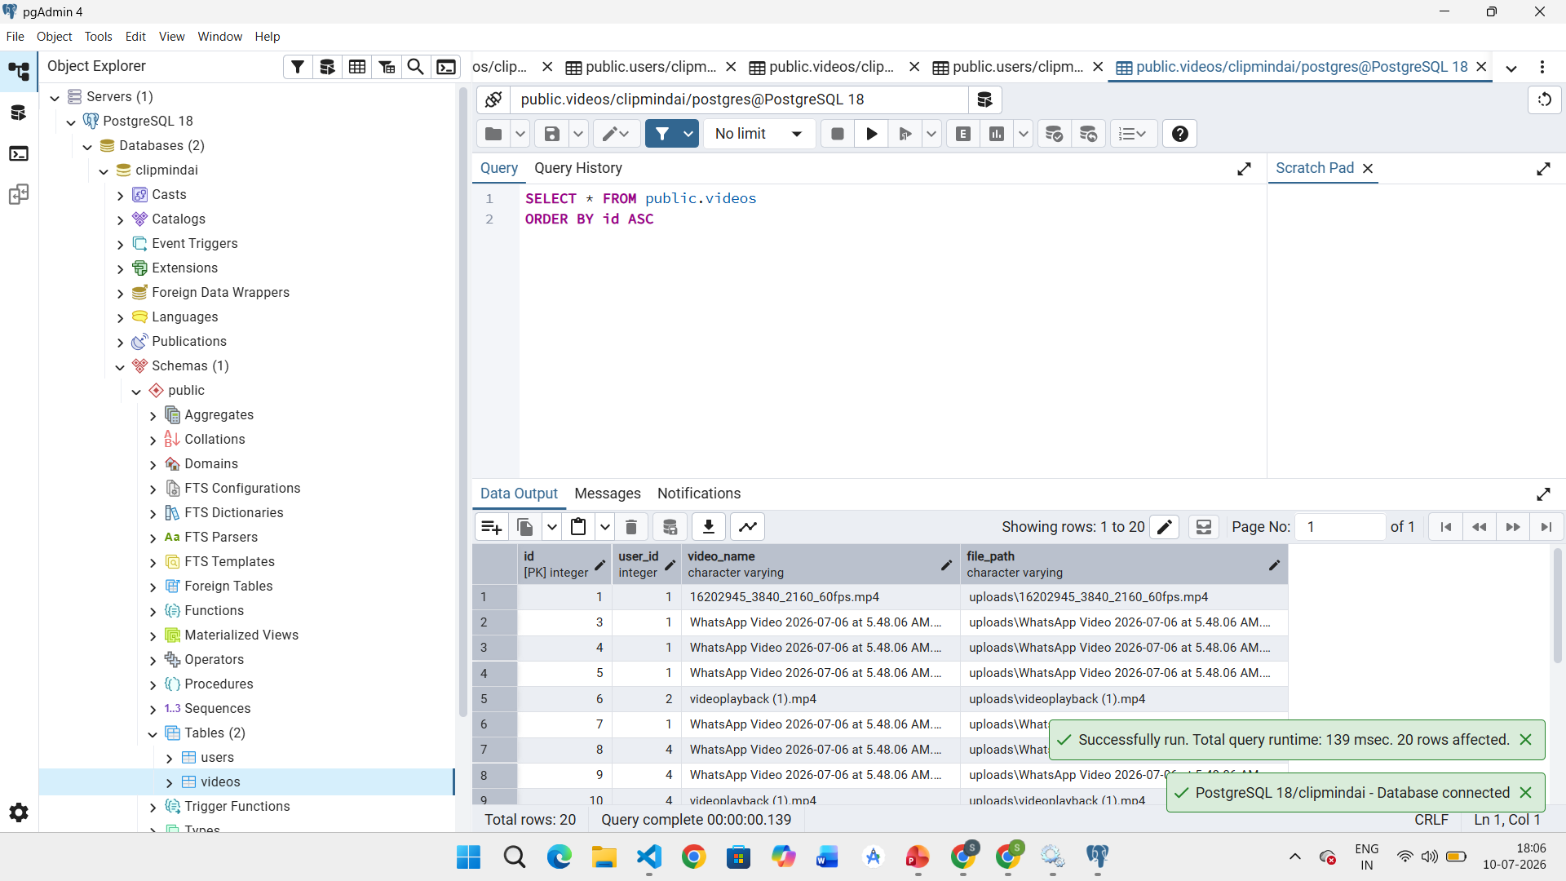

Slide 11
TECHNOLOGIES USED:
Frontend
• React.js
• JavaScript
• HTML
• CSS
• Axios
Backend
• FastAPI
• Python
• SQLAlchemy
• Uvicorn
Database
• PostgreSQL
AI Models
• Whisper AI
• Ollama
• Llama 3.2

